Slide 1
Datacaptatie & visualisatie
Lab 3 Node-RED Dashboarding - variables

Slide 2
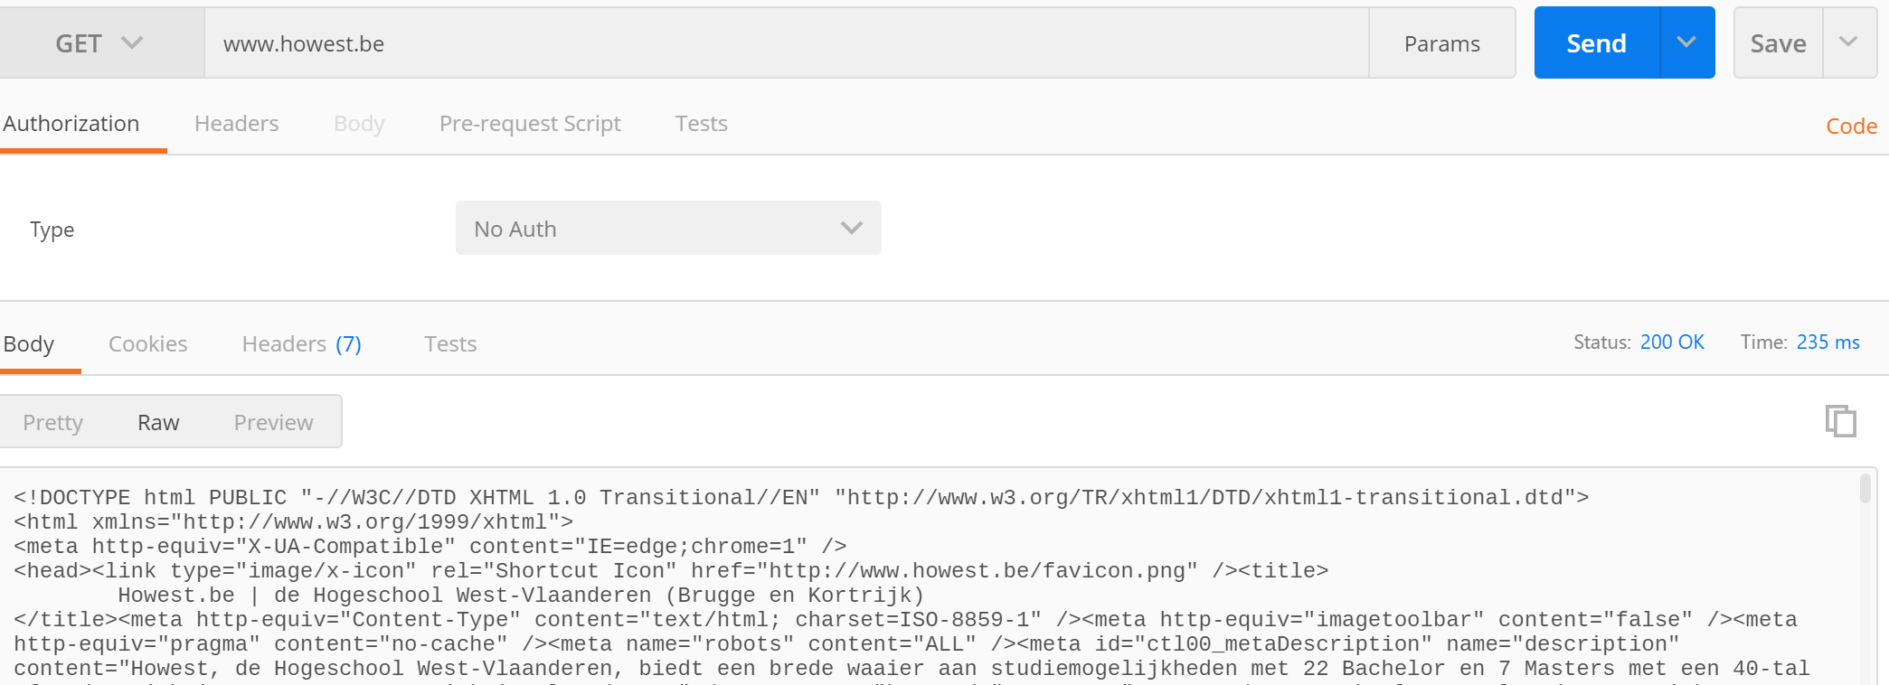
How the internet works?

Slide 3
How the internet works
HTTP GET
Resource requests
Webpagina (html)
Stylesheets (CSS)
JSON Data
Return code
200 = OK
404 = NOT FOUND
500 = Internal Server Error

Slide 4
WEB API
A Web API (Application Programming Interface) is a set of rules and protocols that allows different software applications to communicate with each other over the web.
Intermediary Role: Acts as an intermediary between different applications, enabling them to exchange data and perform tasks seamlessly.
HTTP Protocol: Typically accessed using HTTP protocols.
Types of Web APIs:
Browser APIs: Extend the functionality of web browsers (e.g., Web Audio API)1.
Server APIs: Extend the functionality of web servers.
Common Uses:
Integrating third-party services (e.g., Google Maps API).
Building RESTful services

Slide 5
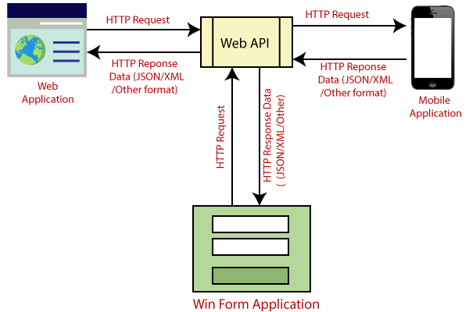
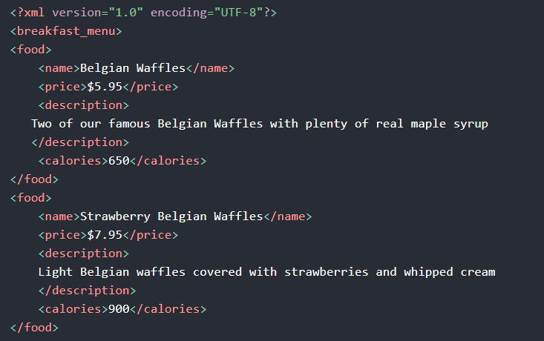
Web API
HTTP bases => Request
Running on server
Response : JSON , XML

Slide 6
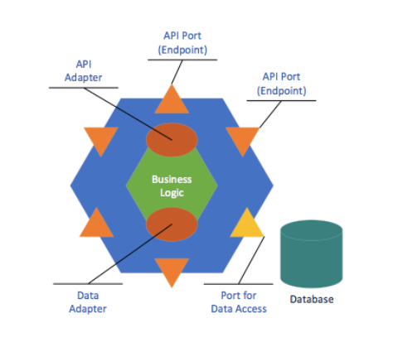
Web API : ENDPOINTS
An endpoint is the end of a communication channel
An endpoint is an URL (Uniform Resource Locator)

Slide 7
Security
Authentication : is knowing the identity of the user. For example, Alice logs in with her username and password and the server uses the password to authenticate Alice.
Authorization : is deciding whether a user is allowed to perform an action. For example, Alice has permission to get a resource, but not to create a resource.
TLS Transport Layer Security encryption : If a website is secured with TLS (the URL starts with ‘HTTPS’-Hypertext Transfer Protocol Secure), the data sent cannot be modified and is encrypted.
Secret key : A good way to control access to your API’s is to use secret keys. With API key authentication, you can verify the identity of each app or user and mitigate the risks of unauthorised access. This information can be used to keep a log and determine the extent of resources accessed.
Tokens : A token is a temporary, dynamically generated credential used to manage user sessions, authorize user or app access, and often encodes session or permission information.

Slide 8
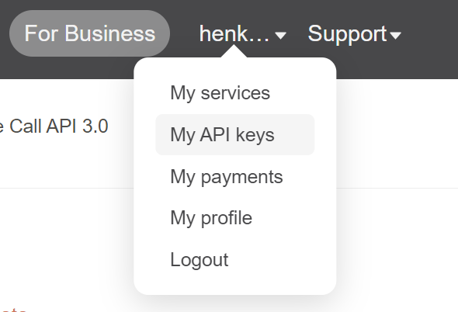
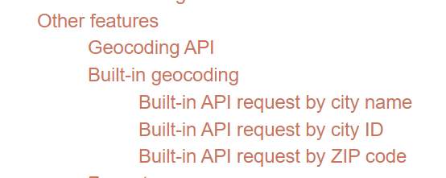
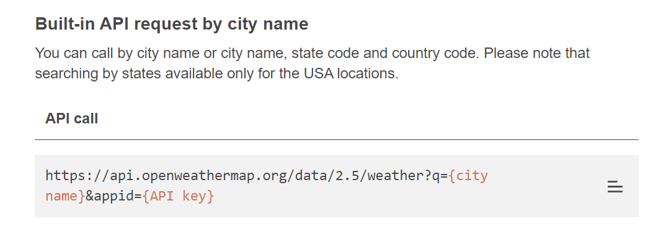
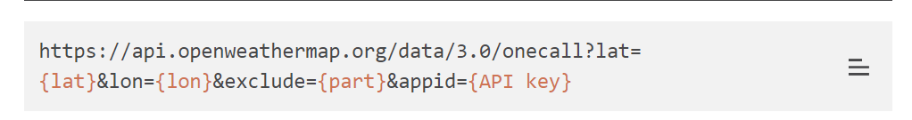
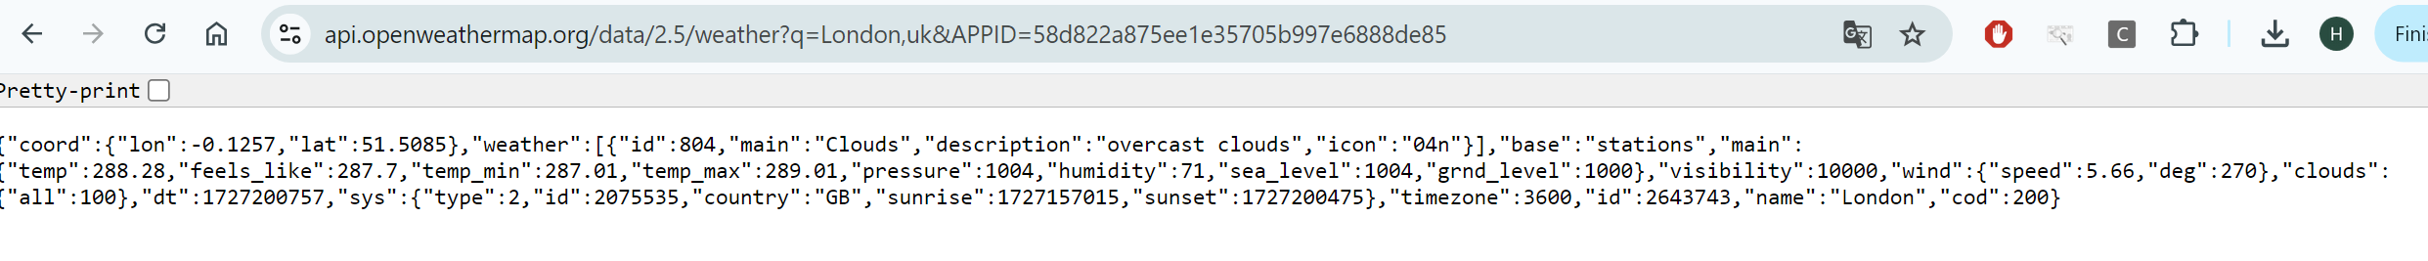
Openweather API
Get API key

Slide 9
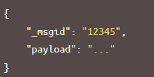
Node-RED : messages
A Node-RED flow works by passing messages between nodes. The messages are simple JavaScript objects that can have any set of properties.
The default property is the payload property.
Node-RED also adds a property called _msgid, this is an identifier.
The value of a property can be any valid JavaScript type, such as:
Boolean - true, false
Number - eg 0, 123.4
String - "hello"
Array - [1,2,3,4]
Object - { "a": 1, "b": 2}
Null

Slide 10
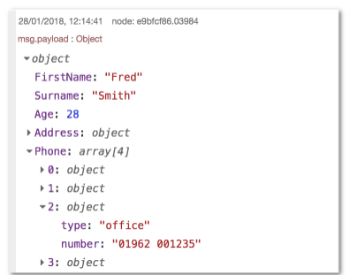
Node-RED : structure of message
When displaying an Array or Object, the sidebar provides a structured view that can be used to explore the message.
At the top it shows the name of the property that has been passed in. Here, the default msg.payload has been used.
Next to the property name is the type of the property - Object, String, Array etc.
It then shows the contents of the property. For Arrays and Objects, the property is collapsed into a single line. By clicking on it, the property will expand to show more detail.

Slide 11
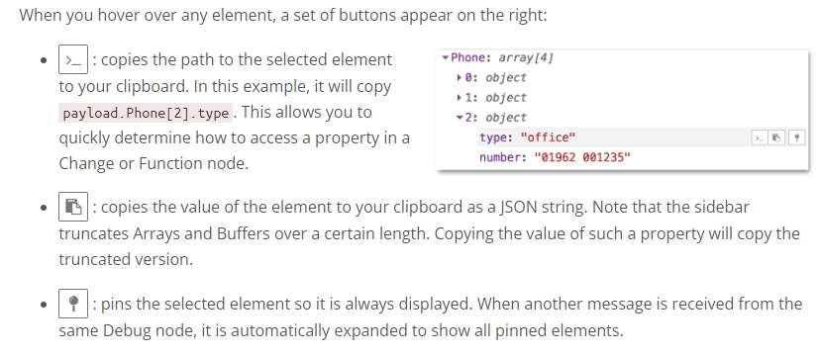
Node-RED : debug window

Slide 12
Node-RED : Modifying a message
Function node => complete flexibility
Change node :
Set a property to a value
Change a String property by performing a search and replace
Delete a property
Move a property

Slide 13
Node-RED environment variables
Node variables, node context variables
Flow variables
Global variables
Environment variables = > store confidential configuration information such as secret and API keys, preventing this data from being accidentally exposed in the flow.

Slide 14
Node-RED : Global variables
Global variables in Node-RED are accessible to function, change, inject, and switch nodes within a given Node-RED instance. They serve as a centralized storage point for data that needs to be accessed across different parts of an application. This is especially useful when you want to share data across multiple flows or tabs within the same Node-RED instance.
For example, in a home automation system with flows for lighting, security, and climate control, global variables can store user preferences or system settings that all flows can access and update. This allows for consistent behavior across the entire system.

Slide 15
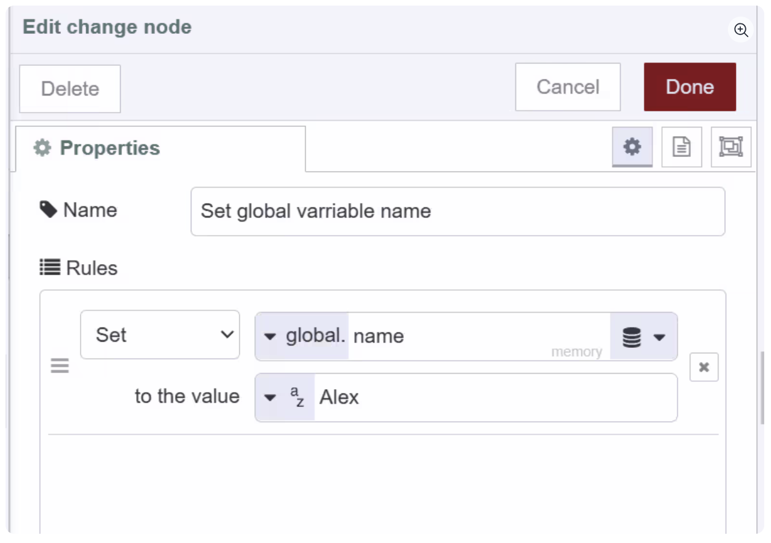
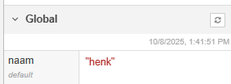
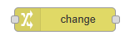
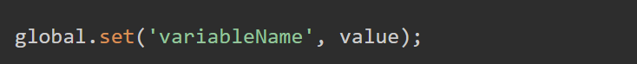
Node-RED : Global variables
Initiating/setting global variable using the function and the change node :
Initiating/setting global variable using the function and the function node :

Slide 16
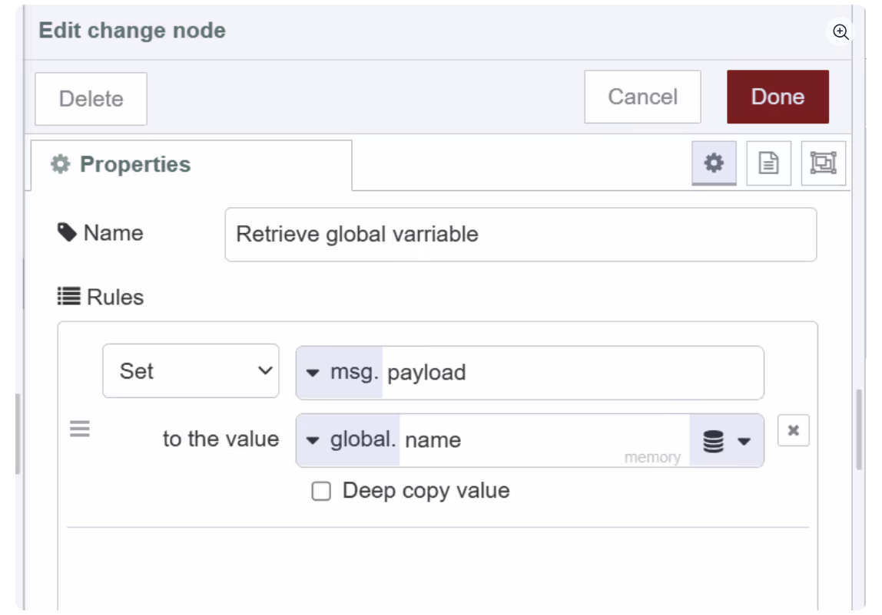
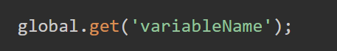
Node-RED : Retrieving global varibles
Change, inject and switch nodes:
Function nodes:

Slide 17
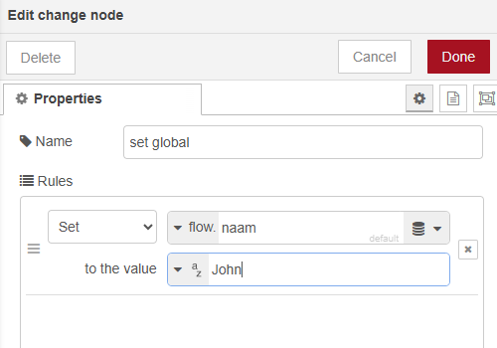
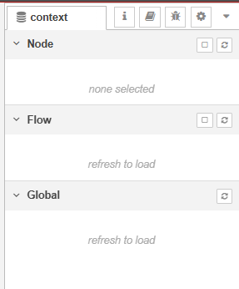
Flow variables
Accessible within the same tab or flow
Change node :
Function node :

Slide 18
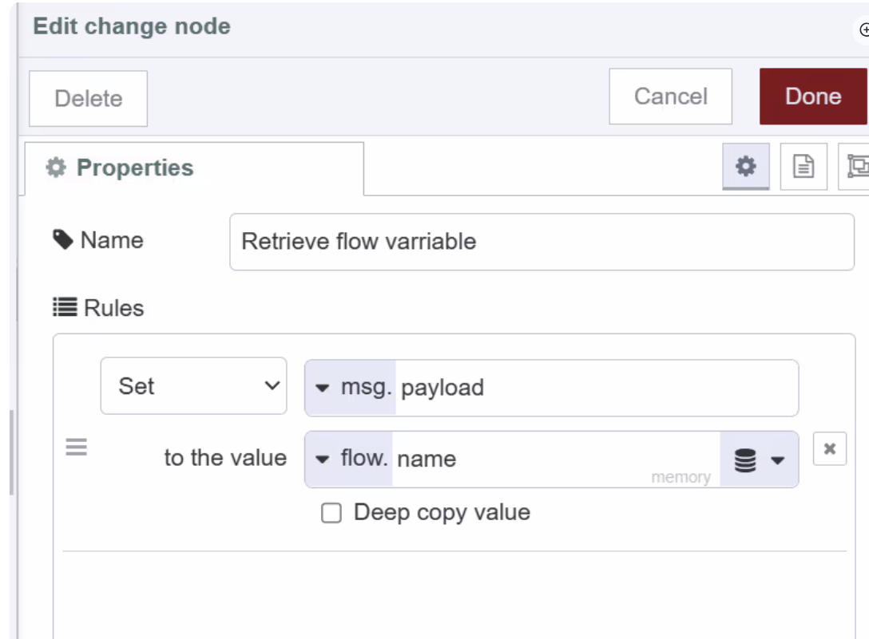
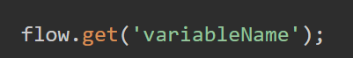
Retrieving flow variable
Change, inject and switch :
Function node:

Slide 19
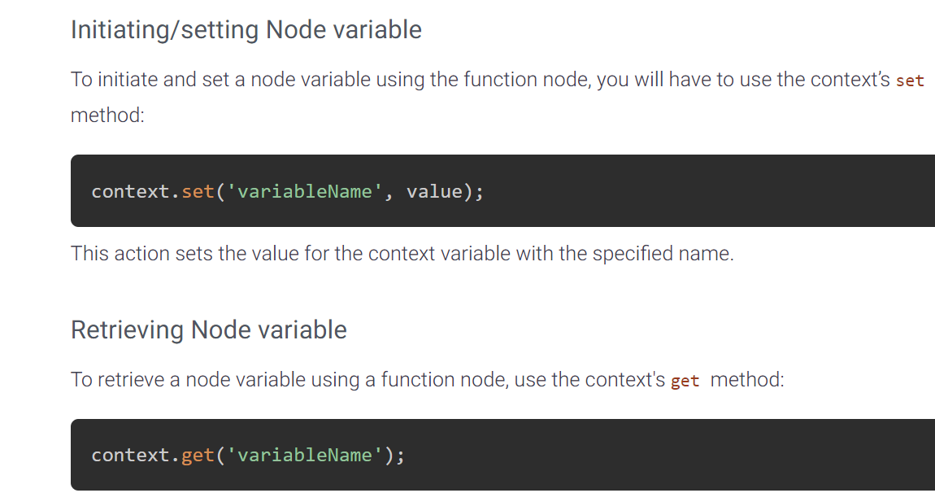
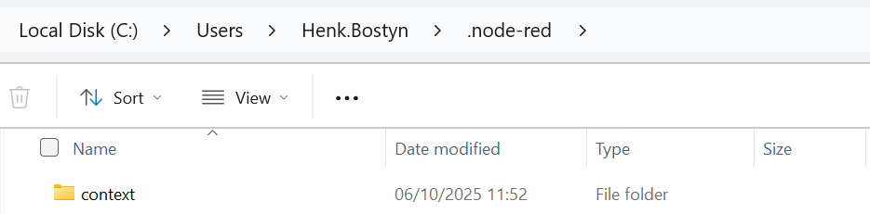
Node variable
Node variables are specific to each node and are only visible within that node. This means we cannot read or write into that variable from outside of the node where it is initialized. This is ideal for cases where you want to store data specific to a single node, to ensure data isolation and prevent interference with other nodes

Slide 20
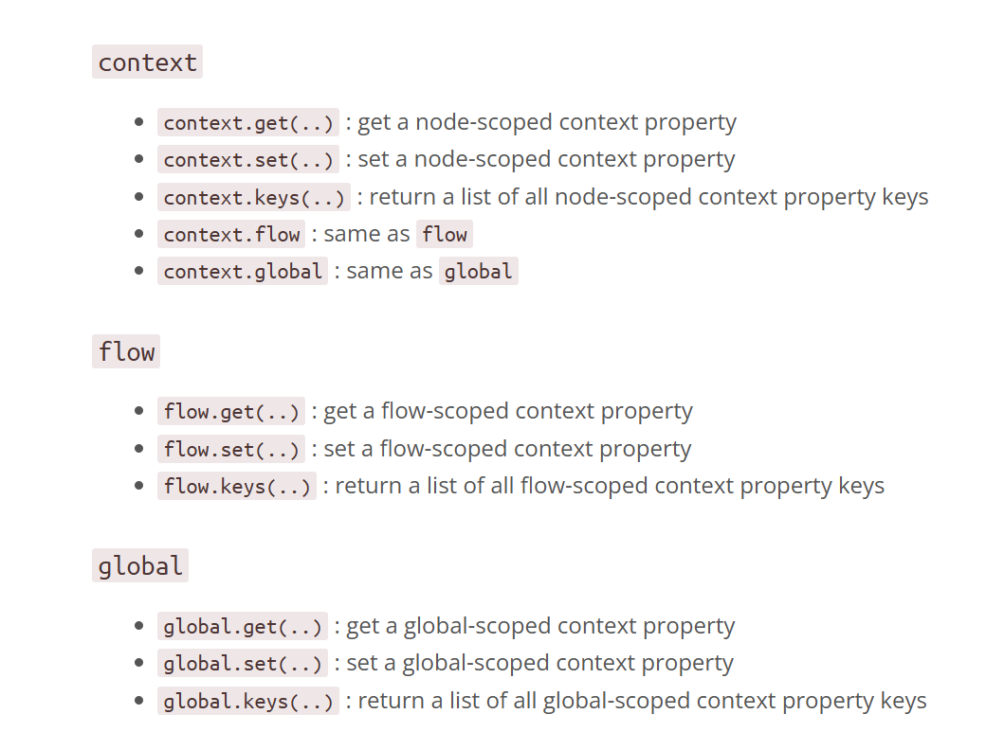
Node-RED Node Variable overview

Slide 21
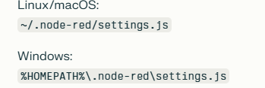
Persistent values
Default => no persistance.
ContextStorage defaults to a single memory store.
Flow, global and node context values exist only in RAM and are lost when Node-RED restarts.
Flow file persistence => are saved to flows.json.
To enable persistent context storage, you must explicitly configure a file-base store in settings.js.
Location:

Slide 22
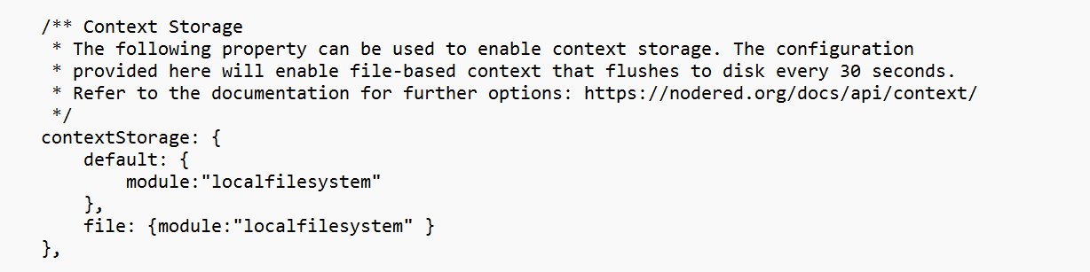
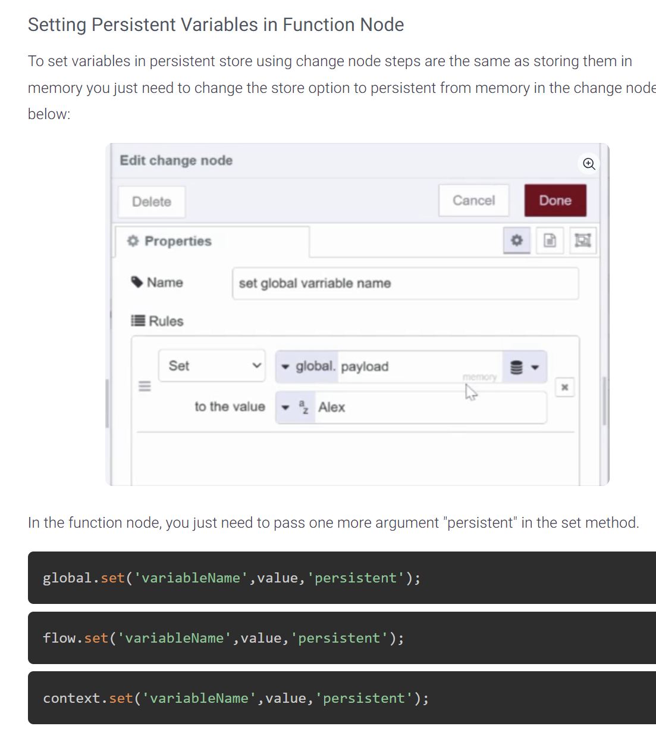
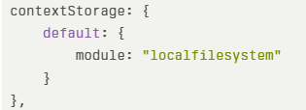
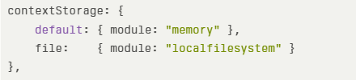

Persistent variables
Create a backup of the settings.js file
Locate or add the contextStorage section.
File storage
Memory and file storage
Restart Node-RED

Slide 23
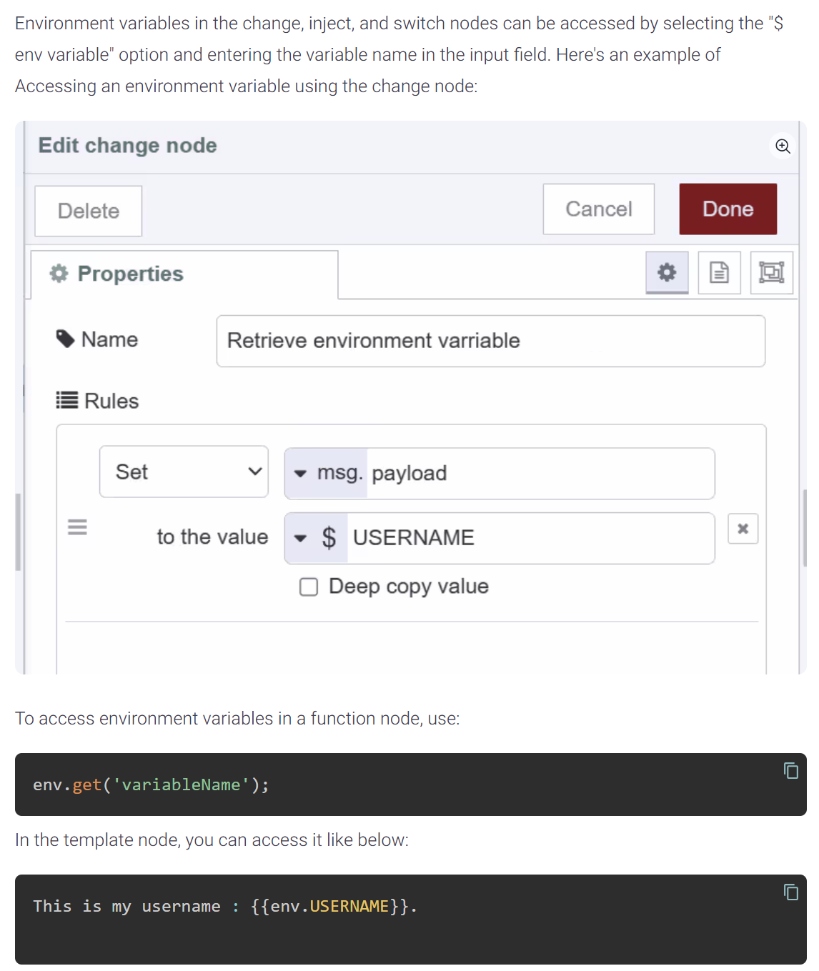
Environmental variables
Environment variables are specifically used for storing sensitive configuration data, such as API keys or database credentials, ensuring this information isn't directly exposed within your flows. In Node-RED you can set environment variables at flow and global level.

Slide 24
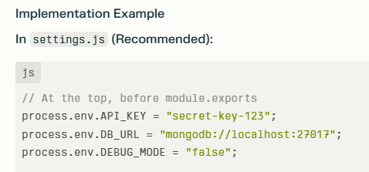
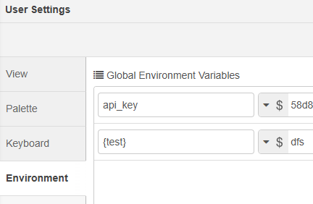
Environmental variables
Purpose: Store configuration and secrets that don't change during flow execution
When set: Before Node-RED starts or when flows are deployed
Scope: Available across all flows and nodes
Persistence: Static - cannot be modified at runtime
Access: env.get('VARIABLE_NAME') or ${VARIABLE_NAME} in node properties
Best for: API keys, database URLs, configuration settings

Slide 25
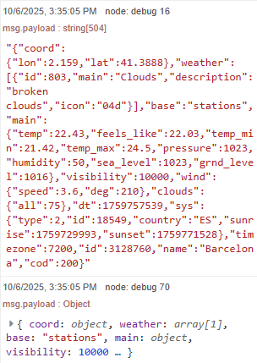
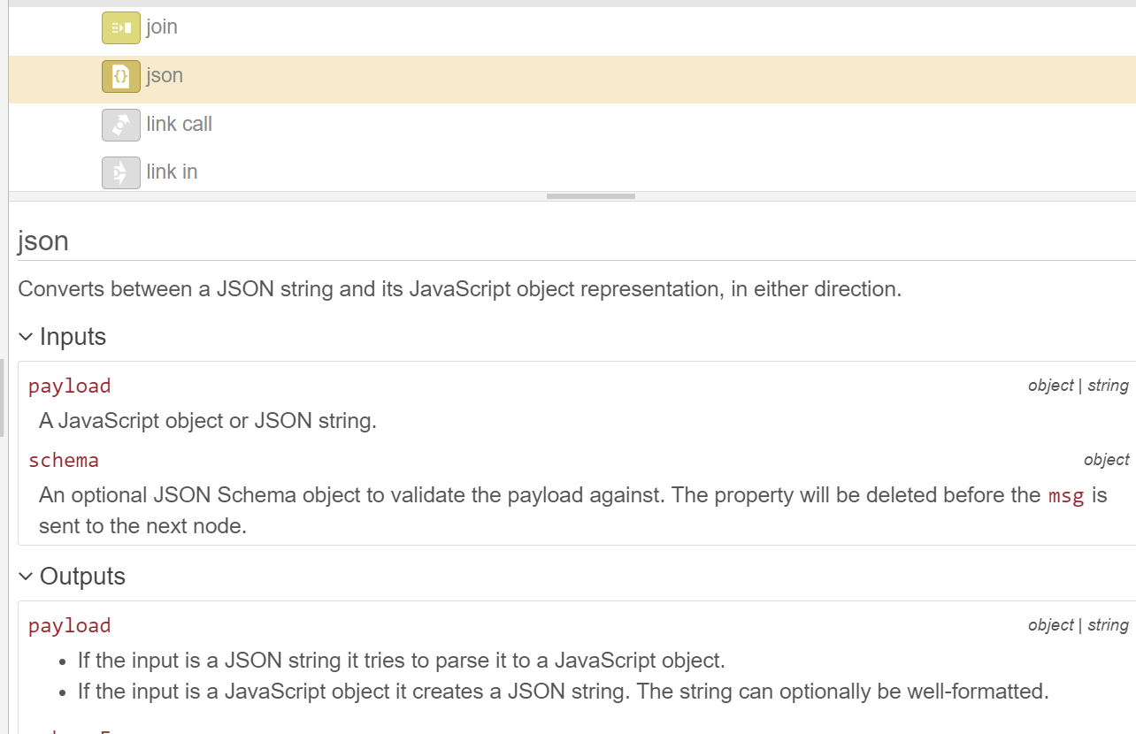
JSON node
It allows you to convert between a JSON-formatted string and a JavaScript object, making it highly versatile for tasks involving JSON manipulation.

Slide 26
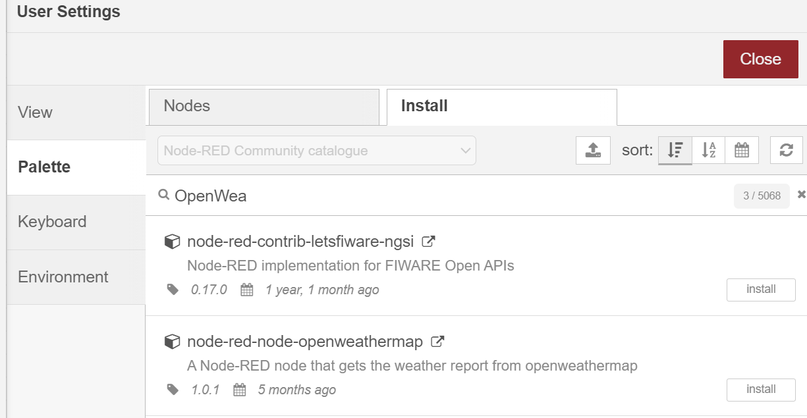
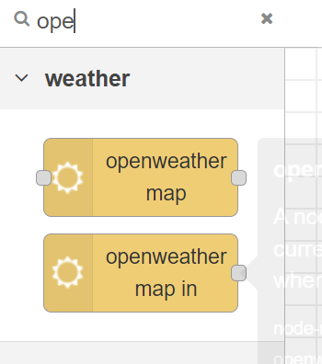
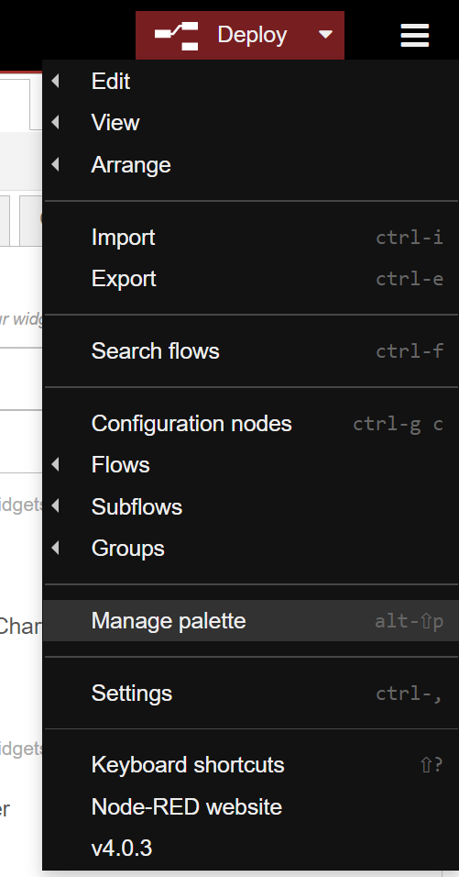
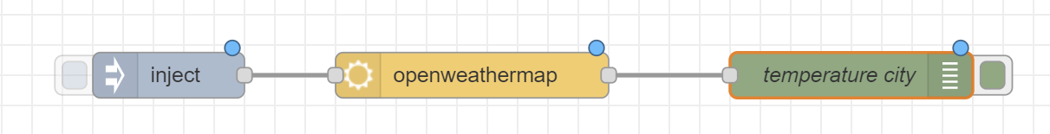
Node-RED => OpenWeather
Manage Palette

Slide 27
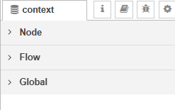
Exercise 1: variables
Create a dashboard to aks the default settings of the user, e.g. name, firstname, city,… Create a group user.
Store those settings in global variables.
Adjust the settings.js so you can choose between memory and file storage.
Test those settings.
Fill in the default settings in the Node-RED dashboard when Node-RED starts up.
Check this in the context menu

Slide 28
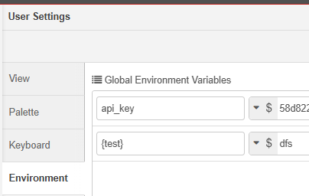
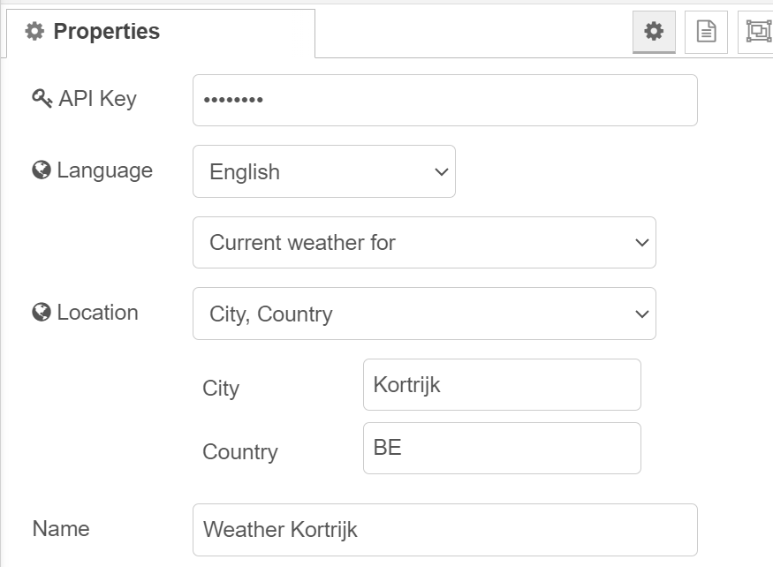
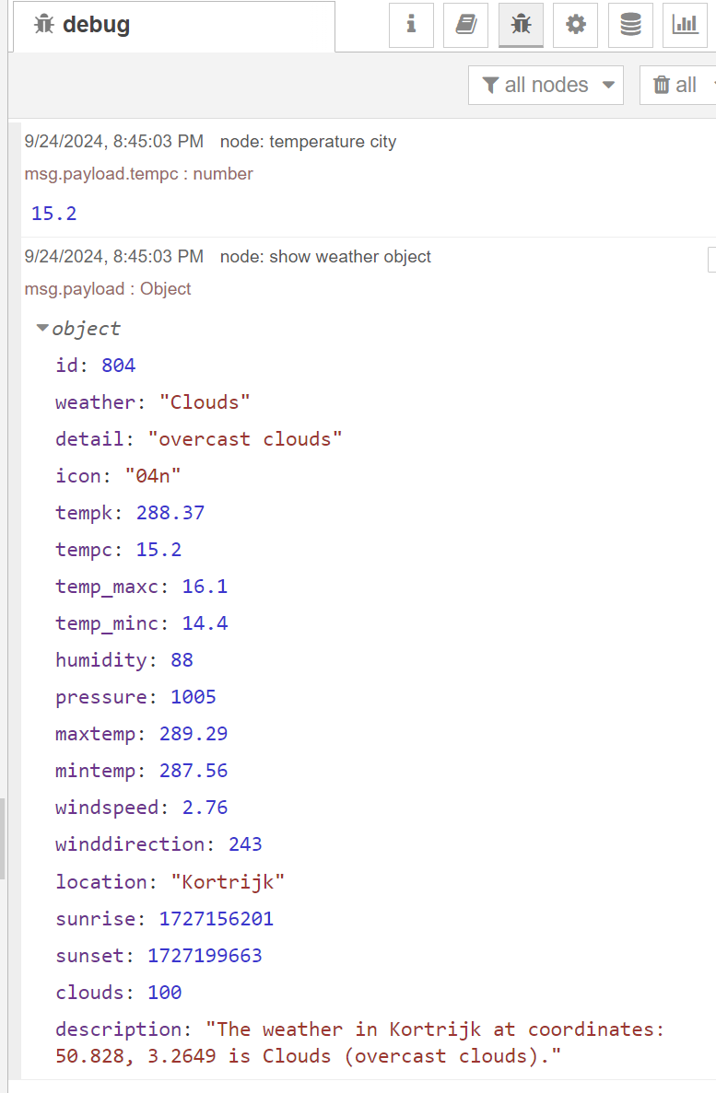
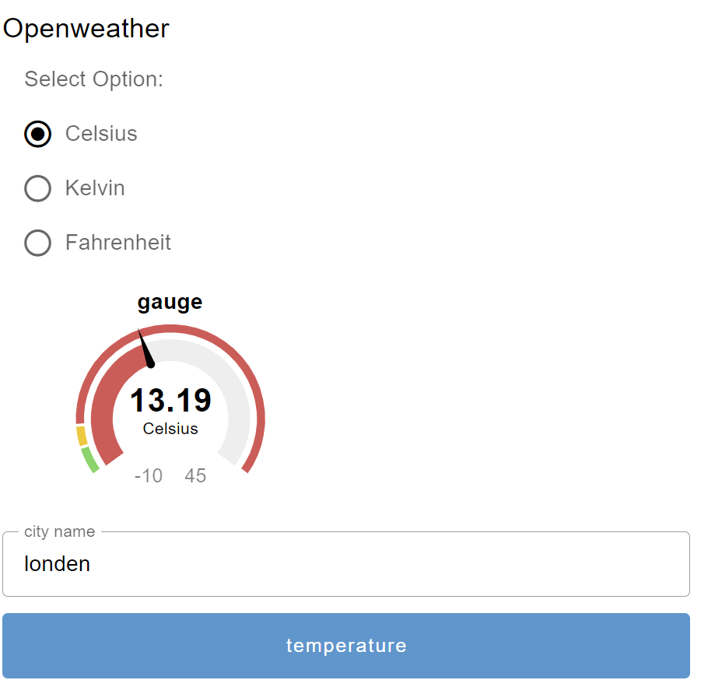
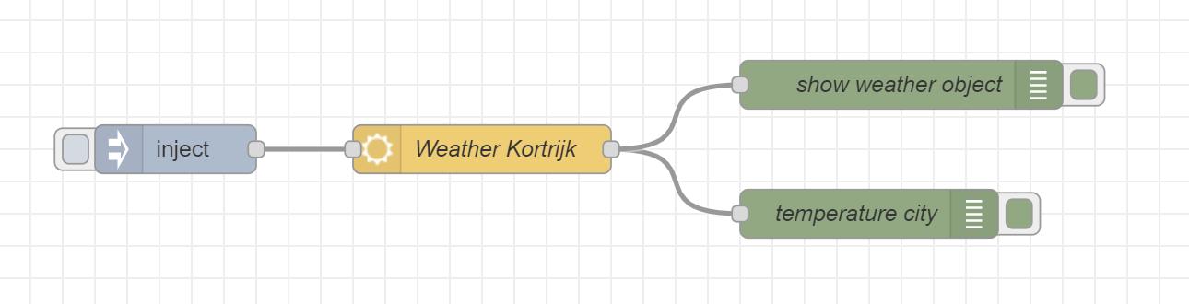
Exercise 2 : OpenWeather Node
Create a new group in your dashboard
Store the API key as an environment variable in the menu
Store the API key in the settings.js file
Create a field for the city and the country
Create a request for the given city
Show the temperature
Show the humidity
Use the usersettings as the default city

Slide 29
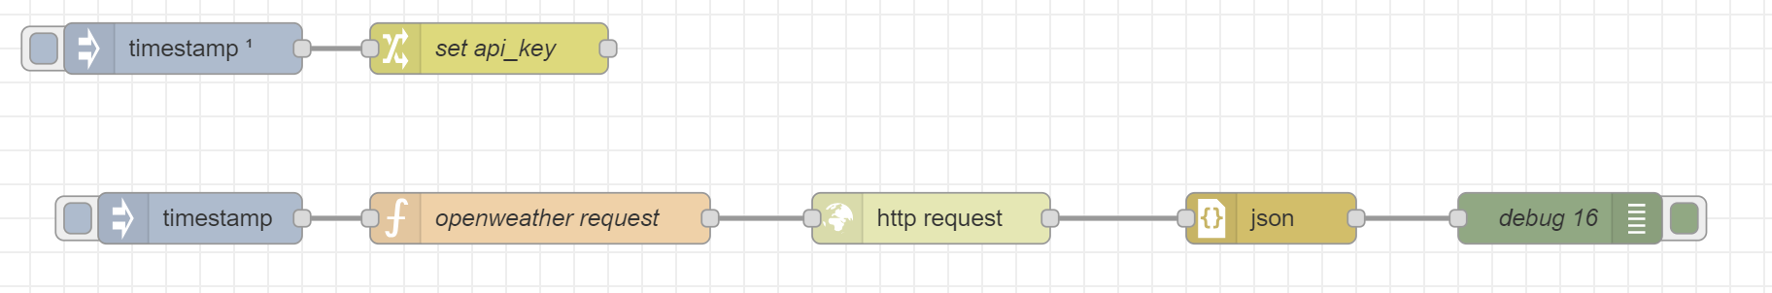
Exercise 3 : Http request
Use the http request to retrieve the weather from Kortrijk
Retrieve the key and city from the variables.

Slide 30
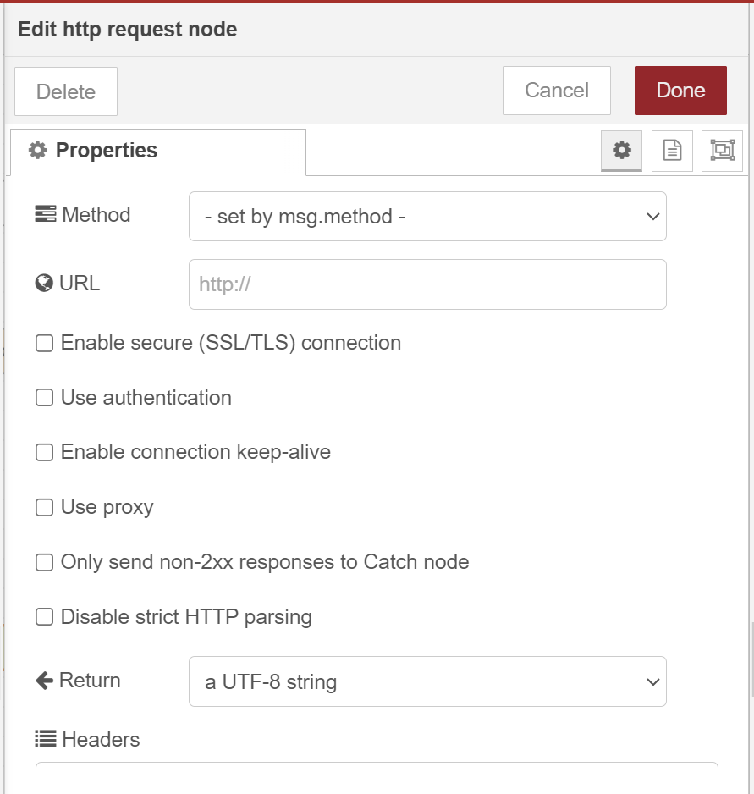
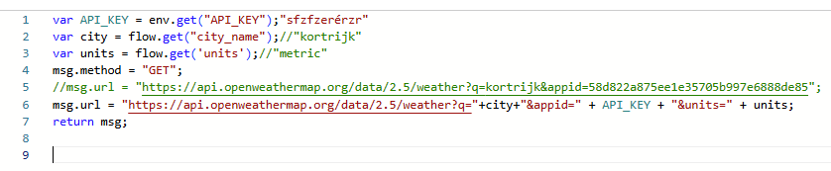
http request

Slide 31
Sources
https://nodered.org/
https://nodered.org/docs/tutorials/
https://noderedguide.com/
https://dashboard.flowfuse.com/
https://flowfuse.com/blog/2024

